Slide 1
Lab 2: Mixed-effects models
April 7, 2016

Slide 2
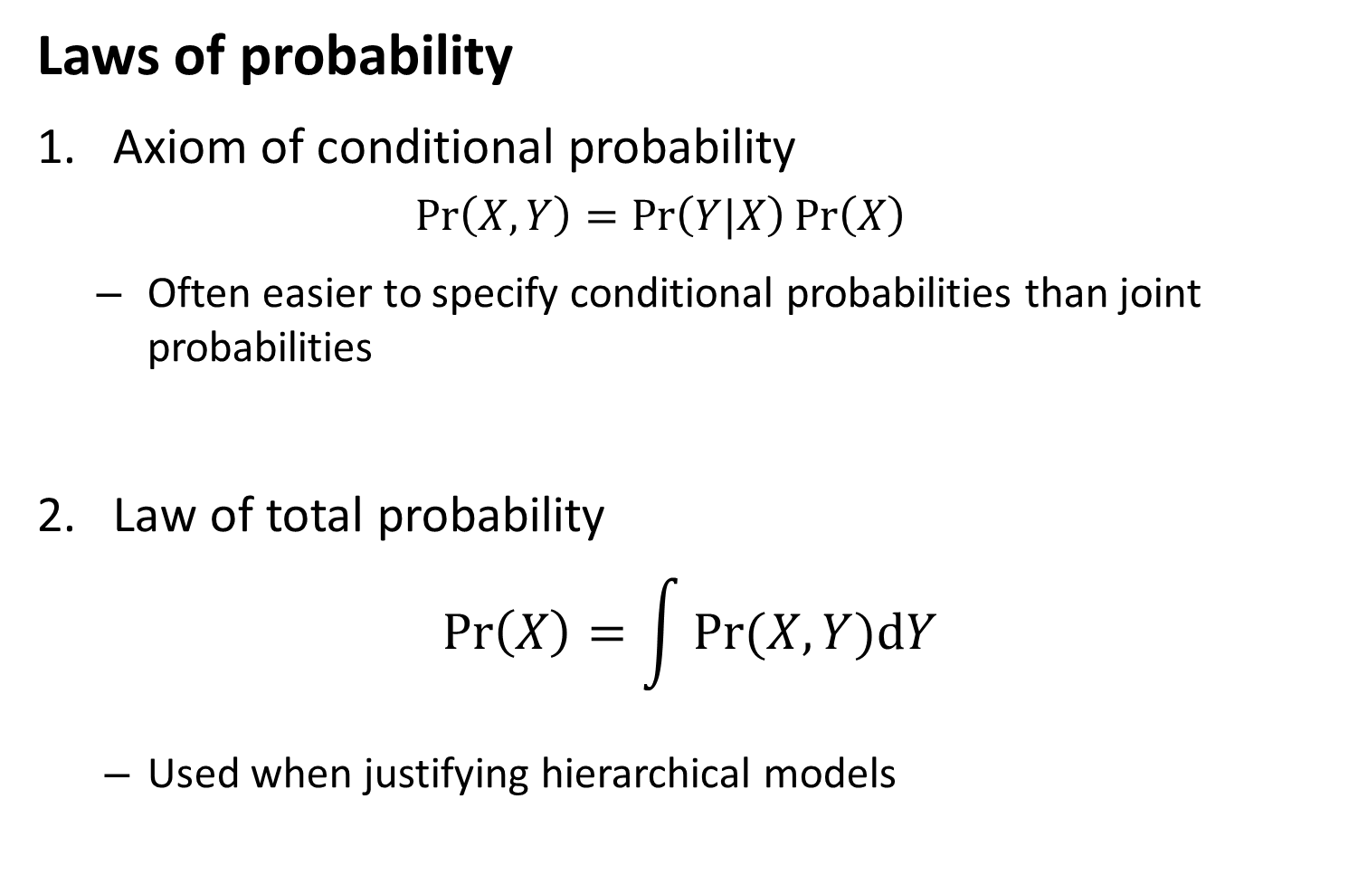
Mixed-effects models
Laws of probability
Axiom of conditional probability
$$\operatorname{Pr}\left(X,Y\right)=\operatorname{Pr}\left(Y|X\right)\operatorname{Pr}\left(X\right)$$
Often easier to specify conditional probabilities than joint probabilities
Law of total probability
$$\operatorname{Pr}\left(X\right)=\int{Pr⁡(X,Y)dY}$$
Used when justifying hierarchical models

Slide 3
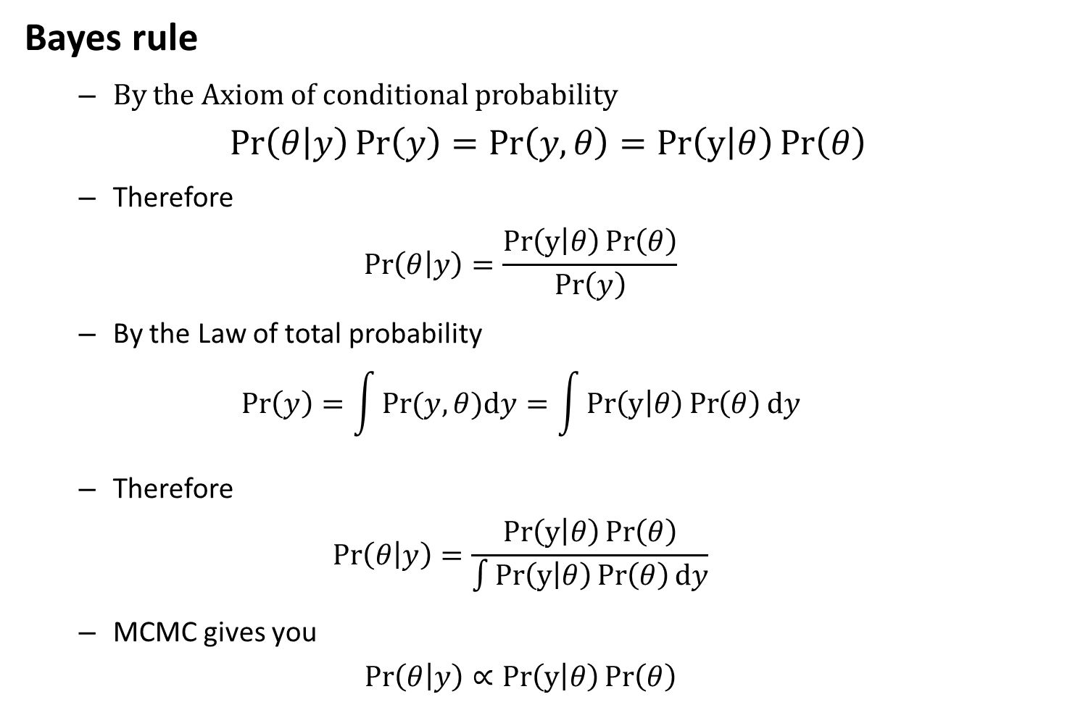
Mixed-effects models
Bayes rule
By the Axiom of conditional probability
$$\operatorname{Pr}\left(θ | y\right)\operatorname{Pr}\left(y\right)=\operatorname{Pr}\left(y,θ\right)=Pr\left(y | θ\right)\operatorname{Pr}\left(θ\right)$$
Therefore
$$\operatorname{Pr}\left(θ | y\right)=\frac{Pr\left(y | θ\right)\operatorname{Pr}\left(θ\right)}{\operatorname{Pr}\left(y\right)}$$
By the Law of total probability
$$\operatorname{Pr}\left(y\right)=\int{Pr⁡(y,θ)dy}=\int{Pr\left(y | θ\right)\operatorname{Pr}\left(θ\right)dy}$$
Therefore
$$\operatorname{Pr}\left(θ | y\right)=\frac{Pr\left(y | θ\right)\operatorname{Pr}\left(θ\right)}{\int{Pr\left(y | θ\right)\operatorname{Pr}\left(θ\right)dy}}$$
MCMC gives you
$$\operatorname{Pr}\left(θ | y\right)∝Pr\left(y | θ\right)\operatorname{Pr}\left(θ\right)$$

Slide 4
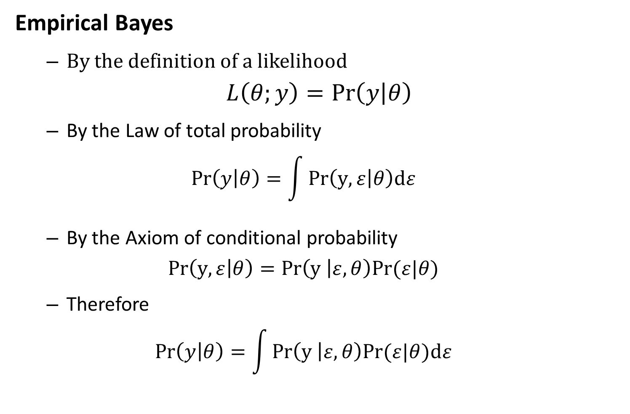
Mixed-effects models
Empirical Bayes
By the definition of a likelihood
$$L\left(θ;y\right)=\operatorname{Pr}\left(y | θ\right)$$
By the Law of total probability
$$\operatorname{Pr}\left(y | θ\right)=\int{Pr\left(y,ε | θ\right)dε}$$
By the Axiom of conditional probability
$$Pr\left(y,ε | θ\right)=Pr\left(y | ε,θ\right)Pr⁡(ε|θ)$$
Therefore
$$\operatorname{Pr}\left(y | θ\right)=\int{Pr\left(y | ε,θ\right)Pr⁡(ε|θ)dε}$$

Slide 5
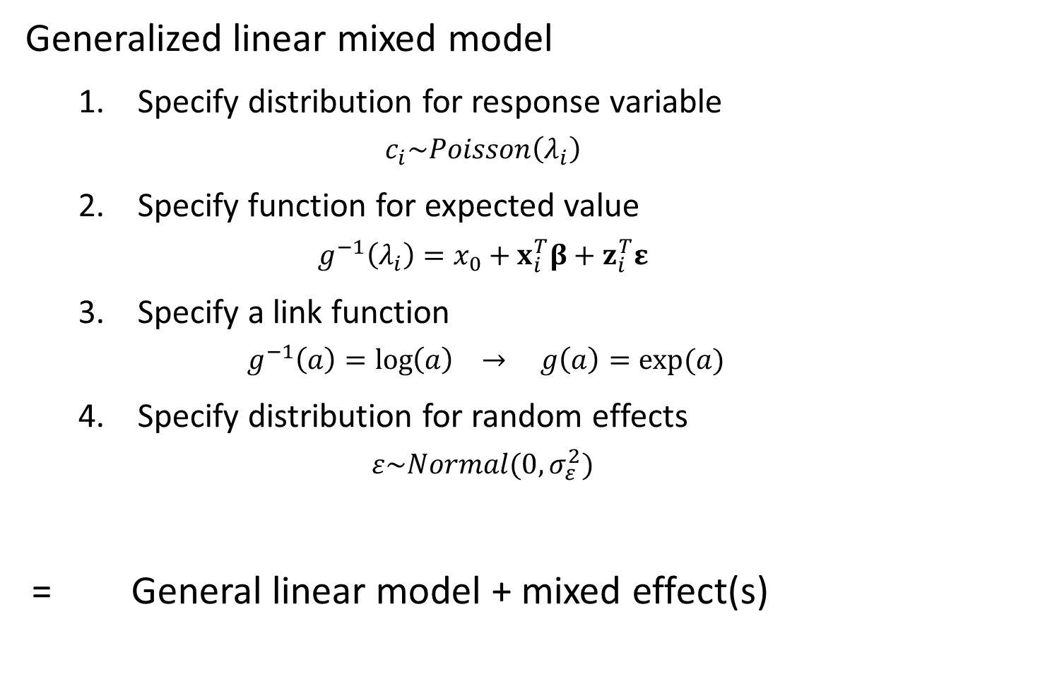
Mixed-effects models
Generalized linear mixed model
Specify distribution for response variable
$$c_{i}\sim Poisson\left(λ_{i}\right)$$
Specify function for expected value
$$g^{−1}\left(λ_{i}\right)=x_{0}+x_{i}^{T}β+z_{i}^{T}ε$$
Specify a link function
$$g^{−1}\left(a\right)=\log\left(a\right) → g\left(a\right)=exp⁡(a)$$
Specify distribution for random effects
$$ε\sim Normal(0,σ_{ε}^{2})$$
= General linear model + mixed effect(s)

Slide 6
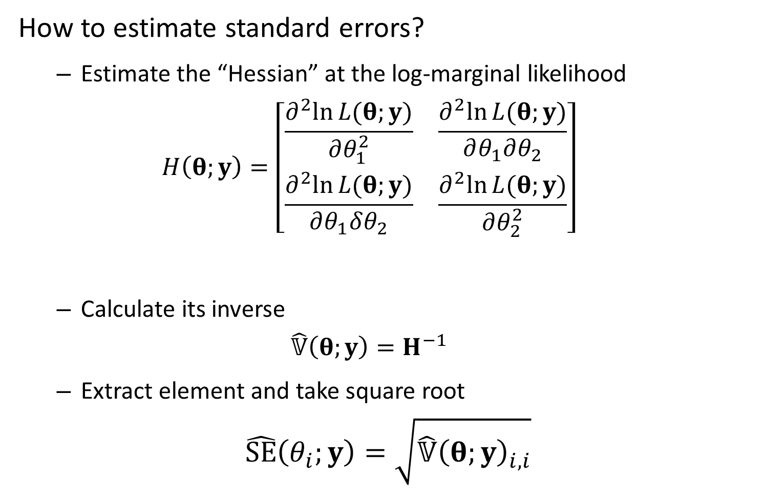
Mixed-effects models
How to estimate standard errors?
Estimate the “Hessian” at the log-marginal likelihood
$$H\left(θ;y\right)=\left[\begin{matrix}\frac{∂^{2}ln⁡L(θ;y)}{∂θ_{1}^{2}} & \frac{∂^{2}ln⁡L(θ;y)}{∂θ_{1}∂θ_{2}} \\ \frac{∂^{2}ln⁡L(θ;y)}{∂θ_{1}δθ_{2}} & \frac{∂^{2}ln⁡L(θ;y)}{∂θ_{2}^{2}}\end{matrix}\right]$$
Calculate its inverse
$$\hat{𝕍}\left(θ;y\right)=H^{−1}$$
Extract element and take square root
$$\hat{SE}\left(θ_{i};y\right)=\sqrt{\hat{𝕍}{\left(θ;y\right)}_{i,i}}$$
Notes:
Standard error – how precisely you’re estimating a parameter

Slide 7
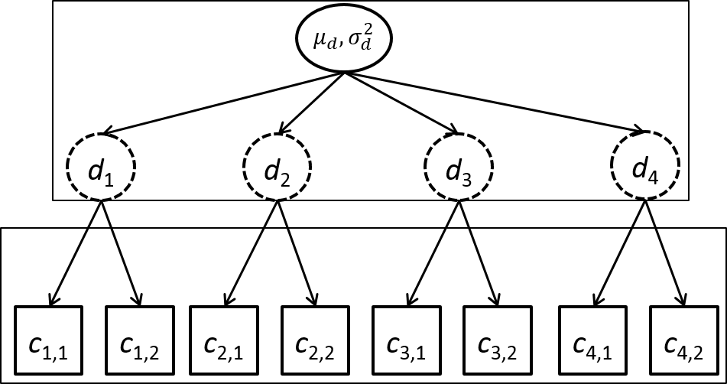

Mixed-effects models
Example – Hierarchical count samples
$$log⁡(d_{j})\sim Normal(μ_{d},σ_{d}^{2})$$
$$c_{i,j}\sim Poisson(d_{j})$$
Counts
4 sites
2 observations/site
3 fixed effects
4 random effects
Notes:
Poisson – benchmark where we measure underdispersion and overdispersion
Poisson process – if we count the number of points drawn on the whiteboard – that is a Poisson distribution – how big your sample space is depends on how many points you count over time
-- as long as everything is independent
2 ways to think about it:
1) infinitely large population – take a count – binomial distribution (small portion of the total) – as sample size moves to infinity, binomial becomes a Poisson
2) distribution of bombings during WWII in London – try to figure out what Germany was aiming at – assume they are aiming at the center but the actual number occurring at any point would be a Poisson – process where each rocket is independent, each point is very small portion of the total – probability of your house getting hit calculated from a Poisson distribution
Rate parameter (underlying rate of horse kicks leading to death) – applied in a spatial dimension
Server – people going to ask to access your server every few min, some days very high traffic – but if you look at small intervals, counts are Poisson distributed
(thing you are counting have to be independent from a common distribution with the same rate)

Slide 8
Mixed-effects models
Simulating data
[See R code]
Notes:
Homework – generating data a little more complicated, fitting with some or no variance terms and its effect on standard error of the mean

Slide 9
Mixed-effects models
Fit using R
Using lme4 package
formula: way to specify model
Linear model – lm(formula= … )
Count ~ 0 + factor(Site)
“Count” – response variable
“0” – Don’t include intercept
“factor(Site)” – Include a fixed effect for each site
Linear mixed model – lm(formula = … | … )
Count ~ ( 1 | factor(Site))
“( 1 | factor(Site) )” – Include a random effect for each site

Slide 10
Mixed-effects models
Fit using R
[See R code]

Slide 11
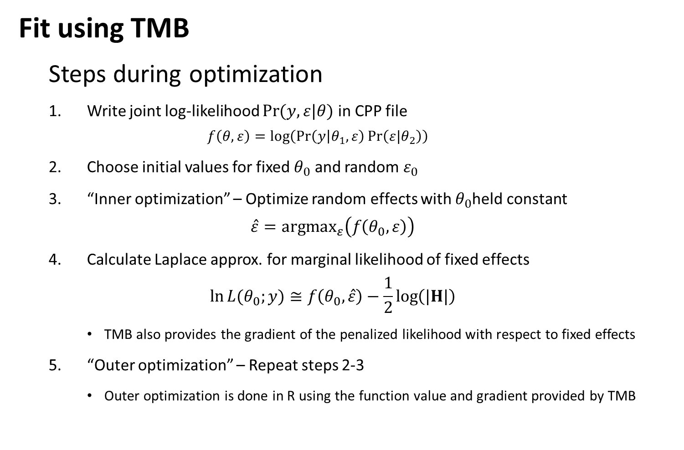
Mixed-effects models
Fit using TMB
Steps during optimization
Write joint log-likelihood $\operatorname{Pr}{(y,ε|θ)}$ in CPP file
$$f\left(θ,ε\right)=log⁡\left(\operatorname{Pr}\left(y | θ_{1},ε\right)\operatorname{Pr}\left(ε|θ_{2}\right)\right)$$
Choose initial values for fixed $θ_{0}$ and random $ε_{0}$
“Inner optimization” – Optimize random effects with $θ_{0}$held constant
$$\hat{ε}={argmax}_{ε}\left(f\left(θ_{0},ε\right)\right)$$
Calculate Laplace approx. for marginal likelihood of fixed effects
$$\ln{L{(θ_{0};y)}}≅f\left(θ_{0},\hat{ε}\right)−\frac{1}{2}\log\left(|H|\right)$$
TMB also provides the gradient of the penalized likelihood with respect to fixed effects
“Outer optimization” – Repeat steps 2-3
Outer optimization is done in R using the function value and gradient provided by TMB

Slide 12
Mixed-effects models
Fit using TMB
[See R code]

Slide 13
Mixed-effects models
Benefits of using linear mixed models
Separate estimate of measurement and between-site variability
Include covariates for either one
Improved precision
“Shrinkage”
Draw-backs
Biased if random effects aren’t “exchangeable”

Slide 14
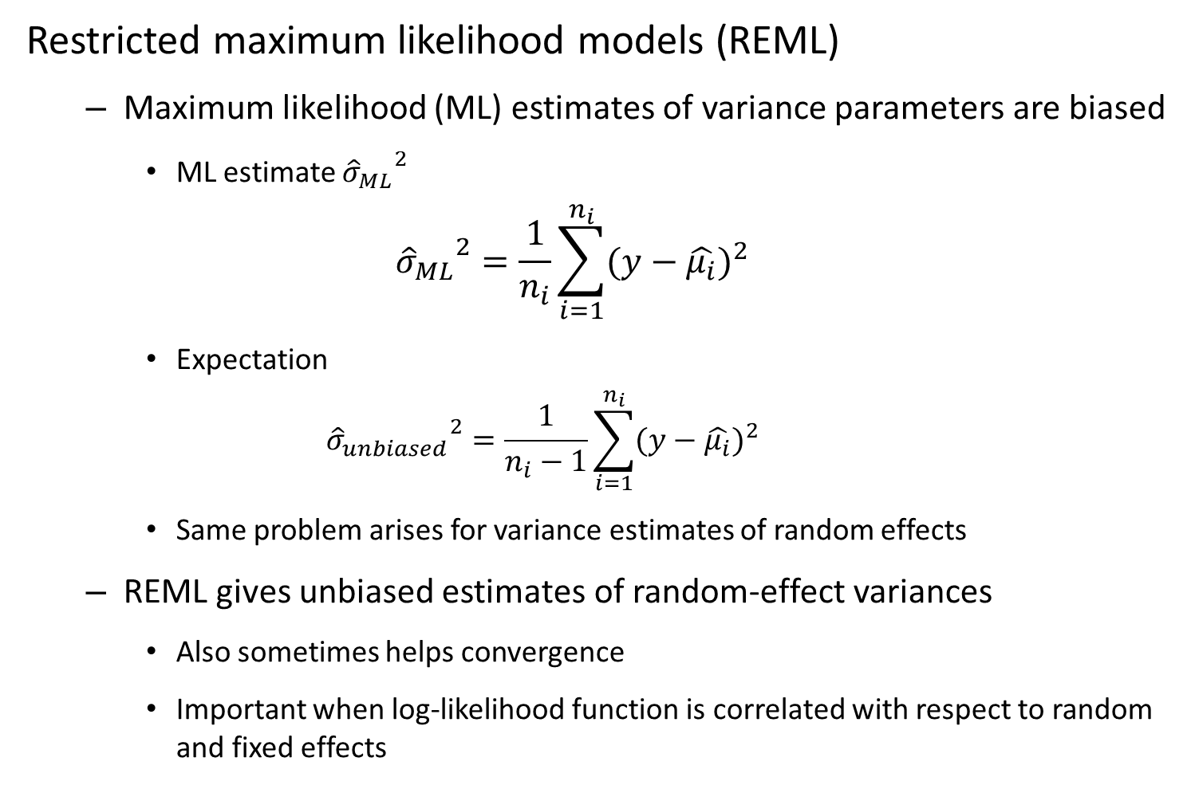
Mixed-effects models
Restricted maximum likelihood models (REML)
Maximum likelihood (ML) estimates of variance parameters are biased
ML estimate ${{\hat{σ}}_{ML}}^{2}$
$${{\hat{σ}}_{ML}}^{2}=\frac{1}{n_{i}}\sum_{i=1}^{n_{i}}{(y−{\hat{μ_{i}})}^{2}}$$
Expectation
$${{\hat{σ}}_{unbiased}}^{2}=\frac{1}{n_{i}−1}\sum_{i=1}^{n_{i}}{(y−{\hat{μ_{i}})}^{2}}$$
Same problem arises for variance estimates of random effects
REML gives unbiased estimates of random-effect variances
Also sometimes helps convergence
Important when log-likelihood function is correlated with respect to random and fixed effects
Notes:
Degrees of freedom bias associated with random effects
TMB – interpret all of nonvariance fixed effects as if they are random
Optimize random effects holding fixed effects constant, then vice versa
Will work really slowly if fixed and random effects are correlated
REML – by dumping some of the fixed effects into inner optimization steps – can make model converge faster (deals with that correlation in the inner optimization step)
Turn REML on, then turn REML off to do fixed effect estimation
Treating fixed effects as random but with improper prior - then can’t do model selection with an improper prior
If you’re having trouble with convergence, turn REML on and see if that fixes things

Slide 15
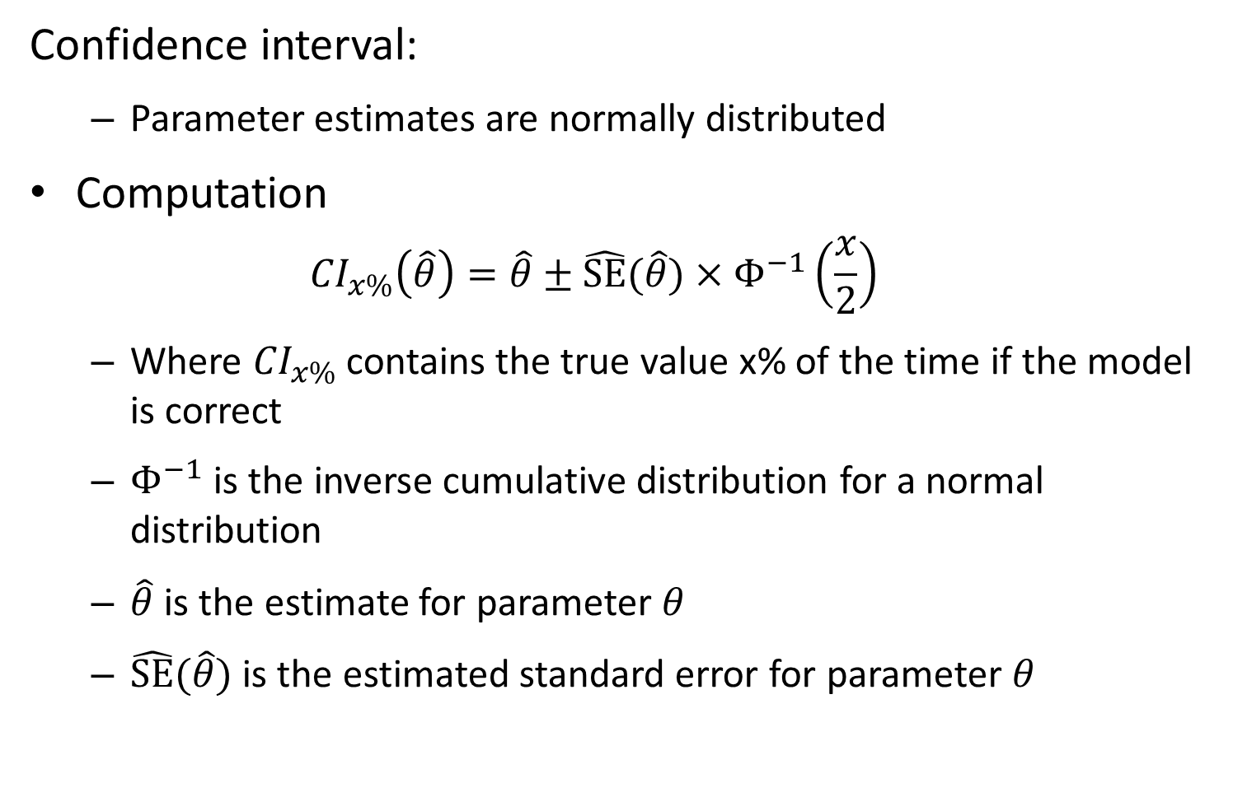
Confidence interval:
Parameter estimates are normally distributed
Computation
$${CI}_{x\%}\left(\hat{θ}\right)=\hat{θ}±\hat{SE}(\hat{θ})×Φ^{−1}\left(\frac{x}{2}\right)$$
Where ${CI}_{x\%}$ contains the true value x% of the time if the model is correct
$Φ^{−1}$ is the inverse cumulative distribution for a normal distribution
$\hat{θ}$ is the estimate for parameter $θ$
$\hat{SE}(\hat{θ})$ is the estimated standard error for parameter $θ$

Slide 16
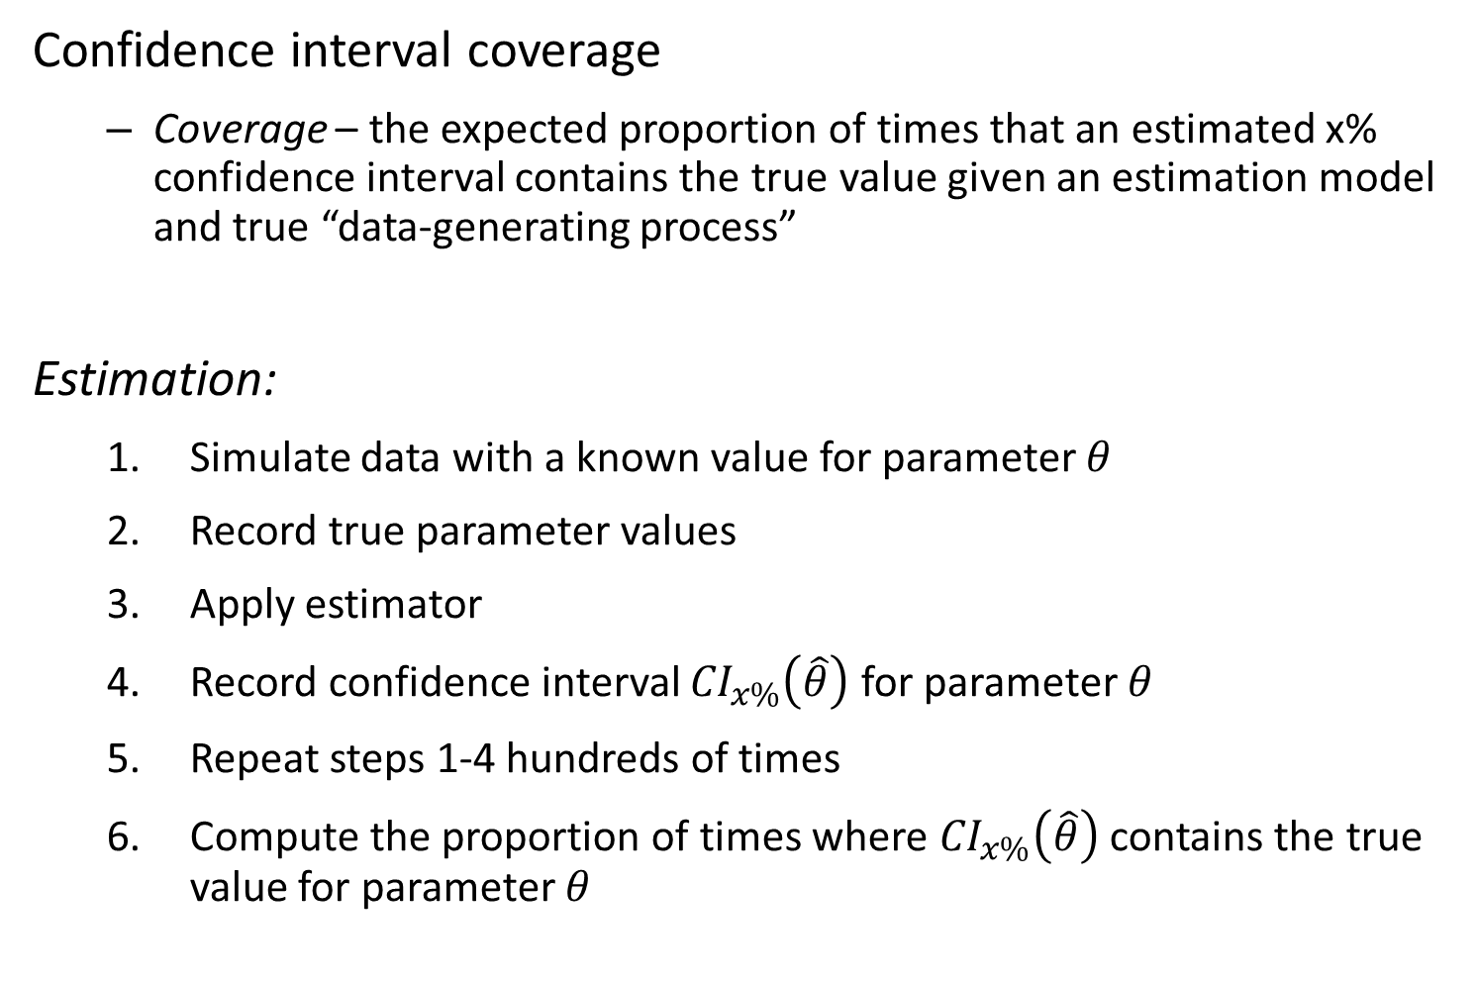
Confidence interval coverage
Coverage – the expected proportion of times that an estimated x% confidence interval contains the true value given an estimation model and true “data-generating process”
Estimation:
Simulate data with a known value for parameter $θ$
Record true parameter values
Apply estimator
Record confidence interval ${CI}_{x\%}\left(\hat{θ}\right)$ for parameter $θ$
Repeat steps 1-4 hundreds of times
Compute the proportion of times where ${CI}_{x\%}\left(\hat{θ}\right)$ contains the true value for parameter $θ$

Slide 17
Mixed-effects models
[Explore “map” argument to TMB]

